Slide 1
Impact-focused research
– how can it become more effective?
What’s the problem?
Hugh Burkhardt
Shell Centre Jubilee Conference
September 2017
Notes:
Systemic change and teaching modelling
Over the last sixty years, teaching modelling has moved from initial explorations to becoming an established field, supported by research and the development well-engineered tools of various kinds. Yet, in typical classrooms around the world, autonomous student modelling remains rare. Recently, in Britain and the US at least, modelling has become an explicit element in the “intended curriculum”. But the usual difficulties of embedding innovation across an education system remain. This talk will analyse these barriers and, drawing on past initiatives around the world, suggest what may be needed to overcome them.

Slide 2
The challenge
When a medical problem arises in health care the Secretary of State calls on:
  leading researchers in the field
  the appropriate Royal College
  NICE (National Institute for Heath and Care Excellence)
for guidance in the design of the response.
When a educational problem arises in education
who does the Secretary of State call on?
who should the Secretary of State call on?
If they called on us, “the research community”, how would we respond?

Slide 3
How we could help: an example
High-stakes exams “set the bar” for most teachers
  It is their “bottom line” in our society
Exam providers compete for schools
  Different priorities – a classic ‘client-customer conflict’
    Government wants “tests worth teaching to”; Schools want best results
Government tried to stop “the race to the bottom”
Great policy – failed through poor engineering, e.g.
  Attacked boards’ business model >> fatal pushback
    Why choose one provider when we only need one exam
  >> micromanaged comparability process – stifles innovation
    Ofqual turned 3 good objectives into 22+ design constraints
  Underestimated design and development challenge
    Boards not organized for innovative design and development
Such initiatives need serious R&D with open competition

Slide 4
The Research <–> Practice synergy
Key elements in research-based fields like medicine:
a body of reliable research
exemplars of tools and processes
funded development programs
stable design teams
systematic iterative development
comparative formative evaluation-in-depth
clear circumstances of use
funded by clients who understand the process

Slide 5
STEM education: Achievements
Insights:
We now know a lot about how children learn, and have developed teaching approaches that are effective for typical teachers across a broad range of learning goals:
  concepts and skills
  extended reasoning
  non-routine problem solving and inquiry
Tools:
There is now a body of materials that are effective in enabling typical teachers
  to help their students achieve these broader goals
  to acquire the extra professional skills needed
And we can design tests that are balanced across the goals “tests worth teaching to”

Slide 6
STEM R&D: Failures
Impact
We have little-or-no influence on key parts of the education system, notably:
  politicians and policy makers
  the design and development of policy initiatives
Mechanisms
There are no established mechanisms for introducing well-proven R&D – insights and tools – into the system in a coherent way.
Little attention has been paid to developing
alternative models for implementing change

Slide 7
Failures continued
Authority
Unlike research-based fields, there is:
No body of generally accepted knowledge – while all fields have areas of disputation, they have a much larger set of research results that are accepted (except by a small fringe)
compare medical research, climate change research v
  “phonics” v “whole reading”
  “skills” v “reasoning” and “problem solving”
and other false dichotomies
No custodians of the knowledge-base – parallel to NICE, the royal colleges in medicine, or the institutes in engineering.
>> No societal acceptance of our expertise (“The Blob”)

Slide 8
Underlying causes include
Mismatched time-scales and priorities
The academic value system in education
Three research traditions out-of-balance
The impact <> funding “catch”

Slide 9
Mismatched timescales and priorities
Ministers change year by year
They each want to “make their mark”
They will be long gone by the time implementation happens and evaluations come in, so
The surface plausibility of an initiative is the key:
  Smaller class size – “common sense” but ineffective+expensive
  Simpler examinations – “obvious” but tests are taught to, so
  Short tasks >> Fragmented curriculum
As in any research field improvement is a gradual process with a decade timescale – but one can
design long-term to deliver year-by-year successes

Slide 10
The academic value system
It currently favours
new ideas over reliable research
new results over replication and extension
trustworthiness over generalizability
small studies over major programs
personal research over team research
first author over team member
disputation over consensus building
Journal papers over products and processes

Slide 11
Three research traditions
Humanities analytic, insight-focused, diagnostic
  observation, analysis, critical commentary
  Key: plausibility, some ‘triangulation’, no testing
  Products: books, articles in journals and media
Science analytic, insight-focused, diagnostic
  observation, analysis, hypotheses
  Key: experimental testing > theory building
  Products: journal articles
Engineering synthetic R&D, solution/treatment-focused
  practical need + prior research > design
  systematic development, marketing
  Products: tools, processes + journal articles

Slide 12
Influence on policy
Humanities
  main influence on policy making BUT
  politicians can do it too – and they do.
  plausibility >> ‘common sense’ initiatives
Science
  Dominates STEM ed research, “informs” policy
  – but no replication, or agreed body of results
Engineering
  still marginal
  – some systematic work in a few places
To achieve research-based practice we need a better balance of R&D effort

Slide 13
The impact<>funding ‘catch’
Improved education is an accepted social priority yet research funding is minimal – e.g.
  ESRC is about 5% of research council funding
  Education is about 5% of ESRC funding
“They can’t be serious”: big challenges need big efforts
CERN LHC, Genome project,…..
BUT
In medicine, science and engineering, research
only got big funding when it was seen to have
a big impact on society:
  Penicillin
  Radar
  The Bomb
Education R&D needs to be seen to have impact, BUT….

Slide 14
The Research <–> Practice synergy
How can we move steadily towards developing:
a body of reliable research
exemplars of tools and processes
funded development programs
stable design teams
systematic iterative development
comparative-formative evaluation-in-depth, defining
clear circumstances of use
authenticated by a
National Institute for Education Excellence?

Slide 15
Impact-focused research in education
– how can it become more effective?
That’s the problem for today
– and, perhaps, the next 50 years
Notes:
Systemic change and teaching modelling
Over the last sixty years, teaching modelling has moved from initial explorations to becoming an established field, supported by research and the development well-engineered tools of various kinds. Yet, in typical classrooms around the world, autonomous student modelling remains rare. Recently, in Britain and the US at least, modelling has become an explicit element in the “intended curriculum”. But the usual difficulties of embedding innovation across an education system remain. This talk will analyse these barriers and, drawing on past initiatives around the world, suggest what may be needed to overcome them.

Slide 16
Impact-focused research in education
– how can it become more effective?
Kaye Stacey
Notes:
Systemic change and teaching modelling
Over the last sixty years, teaching modelling has moved from initial explorations to becoming an established field, supported by research and the development well-engineered tools of various kinds. Yet, in typical classrooms around the world, autonomous student modelling remains rare. Recently, in Britain and the US at least, modelling has become an explicit element in the “intended curriculum”. But the usual difficulties of embedding innovation across an education system remain. This talk will analyse these barriers and, drawing on past initiatives around the world, suggest what may be needed to overcome them.

Slide 17


Moving towards better mathematics education
Kaye Stacey
University of Melbourne
SHELL CENTRE FOR MATHEMATICAL EDUCATION
GOLDEN JUBILEE CONFERENCE
SEPTEMBER 2017

Slide 18
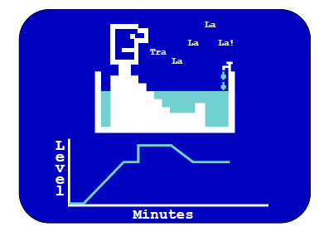

My interactions with Shell
Early reports of good things at Nottingham
  Top destination for Australian teacher educators
1980 “The Real World and Mathematics”; “Beginning to Tackle Real Problems”
1988 - especially Alan Bell’s research program
Many other interactions ever since

Slide 19
Goals
How has the work of the Shell Centre influenced me as an Education Faculty academic ?
  Formal teacher education
  Researcher
  Occasional consultant to government; math ed community involvement
  Working inside the ‘academic value system’
How can this work become more effective?
Three examples

Slide 20
Two Examples of Curriculum Change
Victorian Certificate of Education (VCE) Mathematics
  Years 11 and 12
  Three main subjects (different levels and audience)
  State-wide specified content with options
  Assessment by state with school input – university entrance
Introduction of Problem Solving and Modelling
  from 1988 lasting about a decade
  Unsuccessful ☹
Introduction of mathematically-able software from 1995 to now
  successful, with things to improve and new challenges coming
These are the right directions for mathematics education, and still need a lot of effort from us all.

Slide 21
Example 1: VCE problem solving and modelling: “Tests worth teaching to”
Shift of about one third of assessment from short answer examination questions to
  6 hour problem solving task, students submit report
  20 hour mathematical project, students submit report
Responsibility
  State panel created tasks (with choice) and assessment rubric
  Teacher assessed with inter-school moderation
Associated reduction in course content

Slide 22
Sample problems (images removed)
Questions based on situations such as
  Rates of movement of water and coffee in an old fashioned percolator
  Path of a clown running around a float in a parade
  Exponential function links to music e.g. with guitars
  Concentration of drug in body over time with multiple doses
  investigations of properties of complex numbers

Slide 23
Best Times and Worst Times
Some teachers and students loved it!
Gone within a decade, with little trace remaining.
Problematic introduction
  TIMESCALE Change too fast despite phasing in
    No half-way house for teachers to build skills
    Political imperative - all school subjects involved
  Change too big
    Many teachers had no prior experience of conducting mathematical inquiries
    Some do not believe it is important
    Many other aspects of VCE mathematics changed at same time
Every part needs to work well first time
  Assessment too onerous for schools
  Report production too onerous for schools
  Cheating rumours damaging, despite safeguards (for maths)

Slide 24
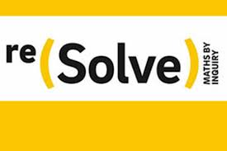
What happened?
Removal of inter-school moderation
Loss of centralised setting of the tasks
Schools exhorted to continue problem solving and modelling as a key feature of the school-assessed component of the subject.
Vanished with little trace in a couple of years
  a few teachers remember it as the best of times.
PS and modelling is still the most important goal, but elusive
  reSolve Mathematics by Inquiry

Slide 25
Example 2:
Graphics calculators and CAS in exams
Research and professional development in association with curriculum authority over many years.
GC is a well designed tool by 1995
  Hand-held for easy classroom use; take home
  Affordable
  Still a challenge for many teachers to learn to use
Successful introduction of graphics calculators
  Phased in over a few years – school choice
  Amplified what students could do, not just compensated
  Relatively small change for teachers
  Compatible with the values of most teachers (not all)
  Associated research on practical issues
    How many questions affected
    Possible new question styles, without making questions too hard
    Equity issues, including brand of calculator

Slide 26

And on to CAS . . .
Gradual introduction from 2002 – 2010, initially with research project partnership
A much bigger change
  Contrary to values of some good teachers and unis
    Compromise with a technology-free exam component 2010
  Much harder for teachers to learn to use
    CAS methods can be different to pen-paper methods
    Still tends to be used like a pen-paper assistant only
  Tends to be used to compensate for poor algebra and not amplify
  Rules continuing to adapt e.g. Mathematica schools
Issues
  How to move on from a ‘soft’ introduction to use it better?
  What is the right maths for 2025?
    reSolve “Mathematics and Algorithmics”

Slide 27
Example 3: Building the knowledge base and making it accessible
Research traditions: science -> engineering
Alan Bell’s research program on diagnostic teaching (1980’s and on)
  researching student learning in detail
    not only general theory
    many studies accumulating and adding variety
    more stable than results in other parts of maths ed research
  building learning materials that use this knowledge
  developing and testing general principles to do this
Underlying rationale: students learn better if teaching addresses student thinking (good evidence now)
Notes:
From my 1988 visit. Inspired some of our work through 1990s – number, algebra, … and eventually led to

Slide 28
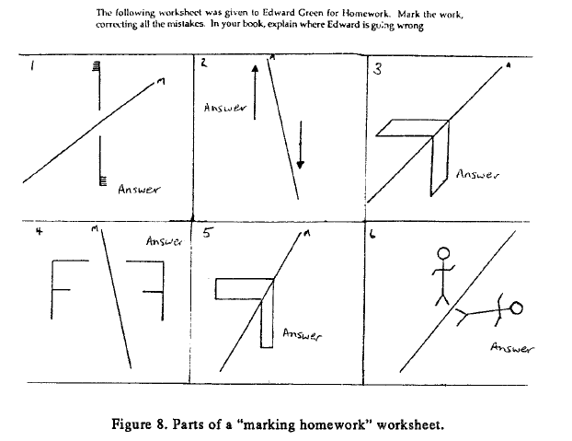
“Principles for the Design of Teaching”
“Some Experiments in Diagnostic Teaching”
Alan Bell, Ed Studs Maths 1993

Slide 29
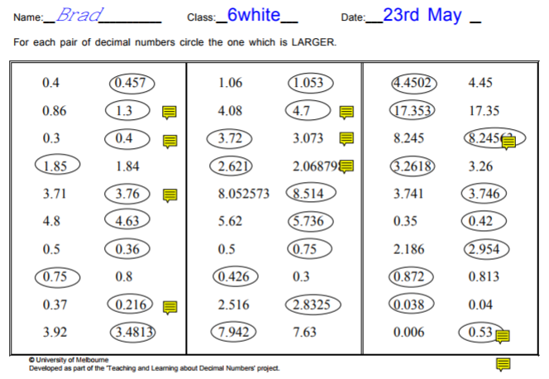
FROM “Teaching and Learning about Decimals” website
1.053 has 53 hundredths
1.06 has 6 hundredths
Test was very popular with teachers
They learned a lot and acted on the information
HARD to diagnose according to rules

Slide 30



The Challenge

Slide 31

Specific Mathematics Assessments that Reveal Thinking (www.smartvic.com)
Vicki Steinle, Beth Price, Eugene Gvozdenko
Fundamental research funded by Australian Research Council, ‘engineering’ research with education systems
Approximately years 5 to 9
Computer delivered, coded and reported
Over 60 topics, pre-test and post-test
Short and focussed on specific topics
Formative assessment, at the point of need

Slide 32
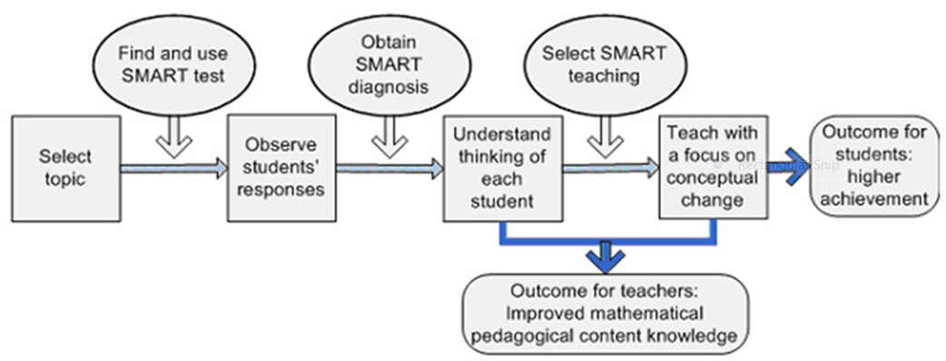
www.smartvic.com)

Slide 33
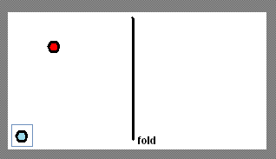
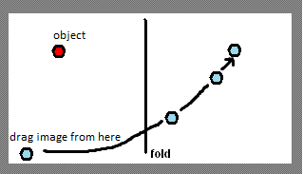
Reflections smart test
Note ‘real world’ scenario with minimal technical language

Slide 34
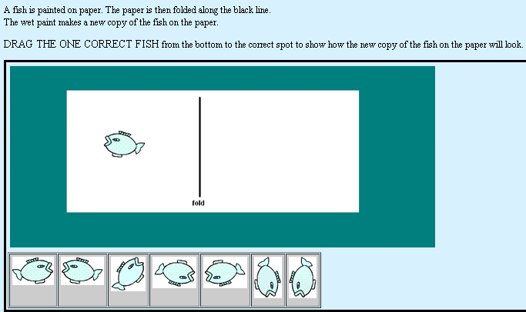
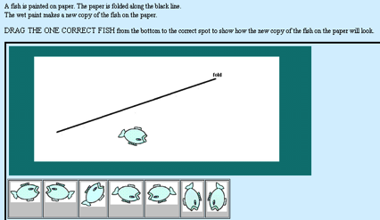
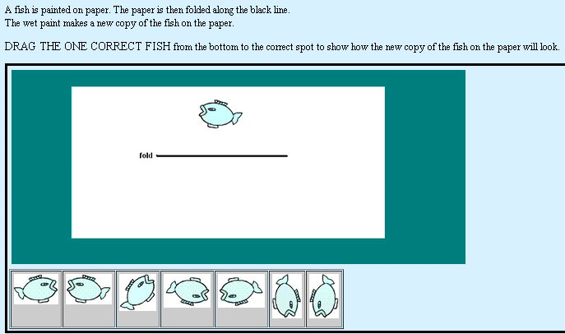
Reflections of complex shapes

Slide 35
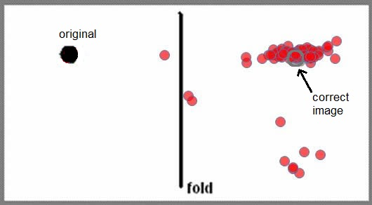
Vertical and horizontal folds
All scattergrams from first 90 students. Overlapped dots not visible.
Horizontal or vertical alignment usually correct
Distance placement poor
  82% correct using generous boundaries
Some unexpected answers

Slide 36
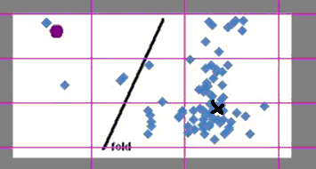
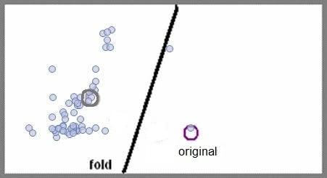
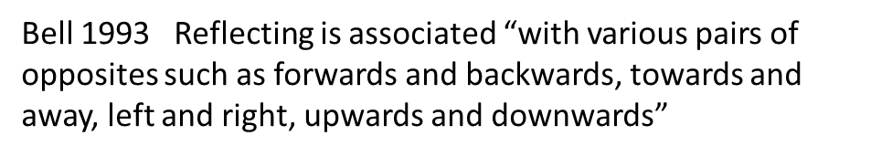
Oblique folds
Much lower success rate (25% with generous boundaries)
Much greater variety of answers
Some ‘pleasing visual balance’ answers %

Slide 37
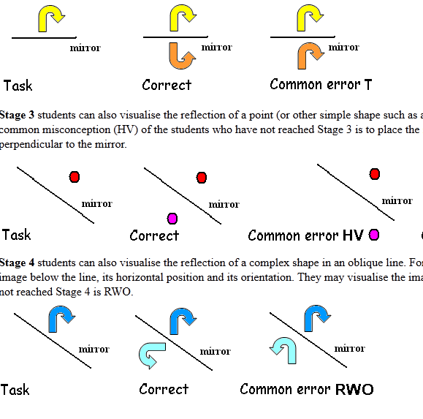
Automated report to teachers
Developmental Stages (4)
Common errors and misconceptions
  Horizontal and/or vertical dominance
  Distance consistently wrong
  Orientation consistently wrong (usually translate)
  Balance positioning - around 10% of students
Advice for teaching

Slide 38
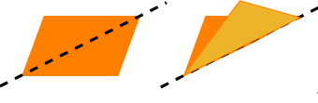
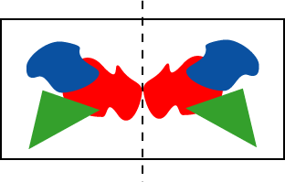
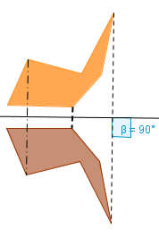
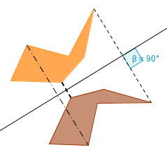
Aspects of Reflections: ALL need attention
Actions
Static Symmetry
Formal
Object – image – line
No concern about how the image got there.

Slide 39
Issues arising ….
A myriad of ‘engineering’ and product design questions
ROLE OF DIAGNOSTIC ASSESSMENT
  Understanding formative assessment
  Not adding to current burden of summative assessment
  Making diagnostic information useful for daily lesson planning
MAKING THINGS EASY FOR USERS
  Highest quality in-depth teacher education is what we need, but ….
  Interviews with students are what we need, but ….
  consider medicine (blood pressure, BMI, ….)

Slide 40
How to increase impact of academic work in mathematics education
Teacher education
  Value disciplined study of MK, PK, and PCK
    Classroom aspects of education studies must earn status – currently very fragile
    Course structures, employment requirements would follow
Research
  Select important problems
  Value the knowledge base; learn it then build on it
    Common MERGA40 message
  Need active synthesis by custodians
    more graduate-level textbooks and fewer research collections
  Research into ‘local’ problems has practical value

Slide 41
How to increase impact of academic work in mathematics education
After the research
  Work on making research results EASY for teachers TO USE
    Compare with ‘simple’ guidelines used by GPs
Building into new commercial IT systems for teaching:
  Mathematics knowledge is embedded in technology. We can do better with it
  Mathematics education knowledge can be embedded into technology. Will we be able to do better with that?

Slide 42
Happy 50th Birthday to the Shell Centre and many happy returns of the day
Kaye Stacey
k.stacey@unimelb.edu.au

Slide 43
Impact-focused research in education
– how can it become more effective?
Alan Schoenfeld
Notes:
Systemic change and teaching modelling
Over the last sixty years, teaching modelling has moved from initial explorations to becoming an established field, supported by research and the development well-engineered tools of various kinds. Yet, in typical classrooms around the world, autonomous student modelling remains rare. Recently, in Britain and the US at least, modelling has become an explicit element in the “intended curriculum”. But the usual difficulties of embedding innovation across an education system remain. This talk will analyse these barriers and, drawing on past initiatives around the world, suggest what may be needed to overcome them.

Slide 44
The Fruits of Collaboration,
Or,
My decade of Engagement and 25 years of Marriage to the Shell Centre
Alan Schoenfeld
Shell Centre 50th, 29 Septembre, 2017
Notes:
Explain the title – met Hugh in 1982, when I came to the Shell Centre
In 1989, NCTM Stds; 1991 NSF RFP for assessment; Hugh calls. “Barren Cow. We’ve been funded collaboratively ever since, 25 years (approx. $18M)

Slide 45
I am tempted to ask the main speakers to choose an issue and ask them to balance…**
The subtle impetus for my talk, from Hugh, in an email June 21, 2017:
** As a pre-emptive strike in your case, “How a pure researcher got real” would fit well. None of the other speakers are pure.

Slide 46
Let me explain…
By beginning at the beginning…

Slide 47
1940, G.H. Hardy:
I have never done anything ‘useful’. No discovery of mine has made, or is likely to make, directly or indirectly, for good or ill, the least difference to the amenity of the world.

Slide 48
1975, A. H. Schoenfeld:

Slide 49
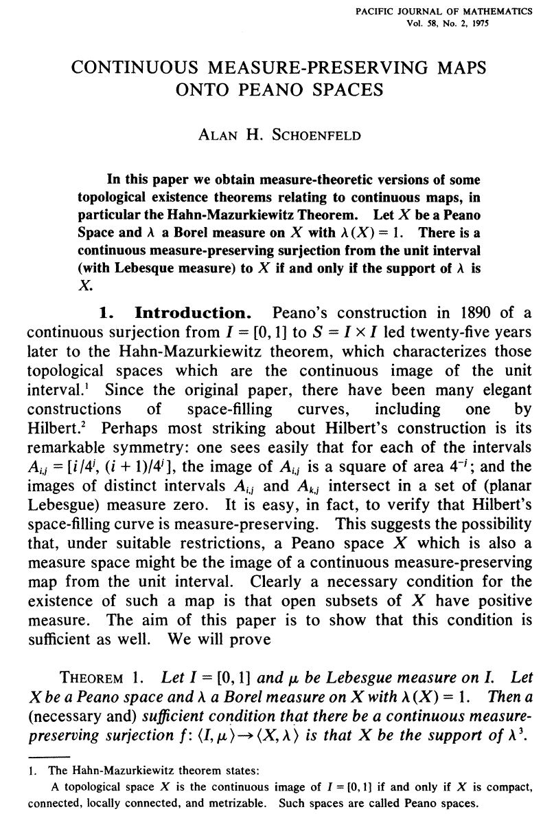
Notes:
You know Freud said, “As the twig is bent, so grows the tree”, so, 35 years later…

Slide 50
2010, Deborah Ball to Alan Schoenfeld:
I don’t understand your pathological need to model everything.
Why would you do that?

Slide 51
2010, Alan Schoenfeld to Deborah Ball:
When I left mathematics I left absolute truth.
It’s easy to bullshit people when you make claims about people and things.
I’m great at bullshit, and models keep me honest. What matters is the search for truth.
Notes:
Sidebar discussion: given an example of how a proof explains why. Tell the extended story of constructing a proof over a year or two, which means you really understand.

Slide 52
Hugh, June 15, 1215:
Truth is irrelevant.
What matters is impact.

Slide 53
So what happens when you mix oil and water?
As I mentioned, we’ve been married for 25 years.
Do you know what they say about long-term partnerships?

Slide 54
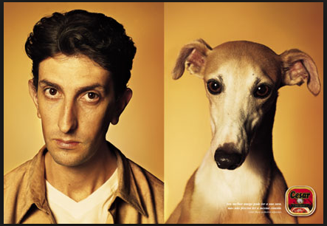

Slide 55


Slide 56
I’ll leave it to you to figure out which one is me and which is Hugh.
Here’s some of the history and its impact on me…

Slide 57
1991: NSF announces grants to build assessments for the Standards
Hugh: Alan, how would you like to be PI on a grant to build assessments?
Alan: Why not? But tell me, why do you want to work in the US?
Hugh: I live in Great Britain. You can’t milk a barren cow.

Slide 58
From 1992 to the present we had a series of partnerships, starting with

Slide 59
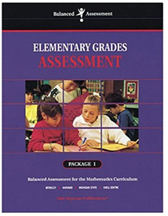


Balanced Assessment

Slide 60

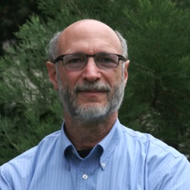
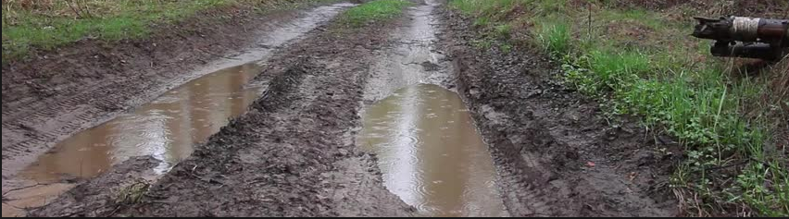
Balanced Assessment work
Mathematical Problem Solving

Slide 61
MARS
Studies of Tutoring, Instructional Materials

Slide 62
Toolkit for Change
Teachers’ Decision Making

Slide 63
Specs for Balanced Assessment
(Leveraging systemic impact)

Slide 64

Formative Assessment Lessons
Teaching for Robust Understanding (TRU)

Slide 65

Network of Improvement Communities
TRU Implementation in Schools

Slide 66
In a moment I’ll show how closely intertwined the ideas behind the FALs and TRU are.
(With TRU math and FALs math, we have everything covered.)
But first a brief intro to TRU.
Notes:
I’ll make a list as you say them.

Slide 67
What are the properties of classrooms from which students emerge as knowledgeable and resourceful thinkers and problem solvers?
Here are our big questions:
Once we know: How can we support teachers in developing the knowledge and skills that enable them to craft such learning environments?
Notes:
Most of you know that I’ve spent nearly a decade working on the first problem, and I have what I believe is a pretty compelling theoretical and practical answer…

Slide 68
What are the properties of classrooms from which students emerge as knowledgeable and resourceful thinkers and problem solvers?
Question 1:
Notes:
Most of you know that I’ve spent nearly a decade working on the first problem, and I have what I believe is a pretty compelling theoretical and practical answer…

Slide 69
Most of you know that I’ve spent many years working on is problem, and I have what I believe is a pretty compelling theoretical and practical answer…
The Teaching for Robust Understanding (TRU) Framework.
Notes:
I’ll make a list as you say them.

Slide 70
I’m going to spare you the details of the R&D that resulted in TRU …
Say Thanks!*
*Schoenfeld, A. H. (2013). Classroom observations
in theory and practice. ZDM, 45: 607-621.
… and give you the bottom lines.

Slide 71
One way to proceed is to list everything the literature says is important – hundreds and hundreds of things – and then (I am a mathematician!) create equivalence classes.
We did that.
Notes:
When we did what I’m about to show you, we had 5 flip charts and my partners in front of the room wrote down what people said. The labels on the top weren’t there, I wrote those on when we were done.

Slide 72
Another is to show people videos of classroom practice, and collect their comments.
We’ve done that, many times.
Notes:
When we did what I’m about to show you, we had 5 flip charts and my partners in front of the room wrote down what people said. The labels on the top weren’t there, I wrote those on when we were done.

Slide 73
The comments always fit into the five equivalence classes
(Which I label after the fact) …
Notes:
When we did what I’m about to show you, we had 5 flip charts and my partners in front of the room wrote down what people said. The labels on the top weren’t there, I wrote those on when we were done.

Slide 74
These are the five dimensions of Teaching for Robust Understanding of Mathematics, or …
– TRU Math –

Slide 75
The Five Dimensions of Powerful Mathematics Classrooms
The Mathematics
Cognitive Demand
Equitable Access to Mathematics
Agency, Ownership, and Identity
Formative
Assessment
The extent to which classroom activity structures provide opportunities for students to become knowledgeable, flexible, and resourceful mathematical thinkers. Discussions are focused and coherent, providing opportunities to learn mathematical ideas, techniques, and perspectives, make connections, and develop productive mathematical habits of mind.
The extent to which students have opportunities to grapple with and make sense of important mathematical ideas and their use. Students learn best when they are challenged in ways that provide room and support for growth, with task difficulty ranging from moderate to demanding. The level of challenge should be conducive to what has been called “productive struggle.”
The extent to which classroom activity structures invite and support the active engagement of all of the students in the classroom with the core mathematical content being addressed by the class. Classrooms in which a small number of students get most of the “air time” are not equitable, no matter how rich the content: all students need to be involved in meaningful ways.
The extent to which students are provided opportunities to “walk the walk and talk the talk” – to contribute to conversations about mathematical ideas, to build on others’ ideas and have others build on theirs – in ways that contribute to their development of agency (the willingness to engage), their ownership over the content, and the development of positive identities as thinkers and learners.
The extent to which classroom activities elicit student thinking and subsequent interactions respond to those ideas, building on productive beginnings and addressing emerging misunderstandings. Powerful instruction “meets students where they are” and gives them opportunities to deepen their understandings.

Slide 76
What’s New, What’s Different?
In a sense, nothing.

Slide 77
That is,
You should recognize and resonate to everything in TRU.
It captures what we know is important. It doesn’t offer any “magic bullets” or surprises.

Slide 78
So, What’s the Point??
Here are 4.

Slide 79
Four central points about TRU:
The TRU Dimensions are necessary and sufficient. That is,
  If things go well along all 5 dimensions, students will emerge from the classroom as powerful mathematical thinkers.
  If things go badly along any of the dimensions, they will not.

Slide 80
Four central points about TRU:
TRU involves a fundamental shift in perspective, from teacher-centered to student-centered.
  The key question is not:
  “Do I like what the teacher is doing?”
  It is:
  “What does instruction feel like, from the point of view of the student?”

Slide 81
Observe the Lesson Through a Student’s Eyes
The Content
What’s the big idea in this lesson?
How does it connect to what I already know?
Cognitive Demand
How long am I given to think, and to make sense of things?
What happens when I get stuck?
Am I invited to explain things, or just give answers?
Equitable Access to Content
Do I get to participate in meaningful math learning?
Can I hide or be ignored? In what ways am I kept engaged?
Agency, Ownership, and Identity
What opportunities do I have to explain my ideas? In what ways are they built on?
How am I recognized as being capable and able to contribute?
Formative Assessment
How is my thinking included in classroom discussions?
Does instruction respond to my ideas and help me think more deeply?
Notes:
Even better, you can frame the observations from the point of view of the student.
Imagine their experiences, with summaries organized in those five columns.

Slide 82
Four central points about TRU:
There are no “thou shalts” in TRU. TRU does not tell you how to teach, because there are many different ways to be an effective teacher.
  TRU serves to problematize instruction. That is: Asking, “how am I doing along this dimension; how can I improve?” can lead to richer instruction without imposing a particular style or norms on teachers.

Slide 83
Four central points about TRU:
4. TRU is NOT a tool or set of tools.
  TRU is a perspective regarding what counts in instruction, and
  TRU provides a language for talking about instruction in powerful ways.
  With this understanding, you can make use of any productive tools wisely.

Slide 84
But we have tools, of course…
See
http://map.mathshell.org
for evidence, and for most of the tools I’ll show you when discussing Q2.

Slide 85
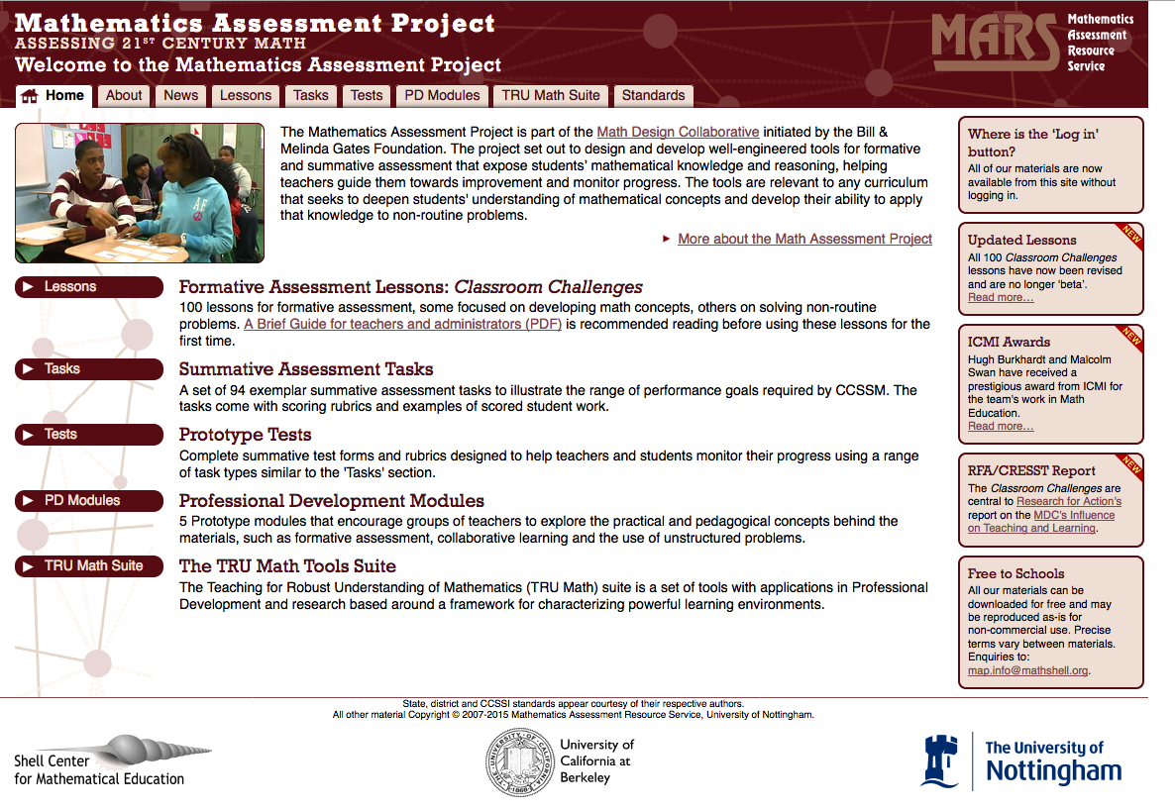

Slide 86
Question 2:
How can we support teachers in developing the knowledge and skills that enable them to craft such learning environments?
Notes:
Most of you know that I’ve spent nearly a decade working on the first problem, and I have what I believe is a pretty compelling theoretical and practical answer…

Slide 87
I will first focus on some available tools, and then describe a strategy (and some more tools) we are implementing.
Notes:
It’s time for me to tell you about some tools, and then about strategies for change.

Slide 88
The Mathematics Assessment Project has produced 100
“Formative Assessment Lessons”
(FALs) to help teachers engage in “diagnostic teaching.”
Tools to Support
Powerful Classroom Instruction

Slide 89
There have been more than 7,000,000 lesson downloads.
I’m going to race through one 2 ½-day lesson to give you a sense of it.

Slide 90
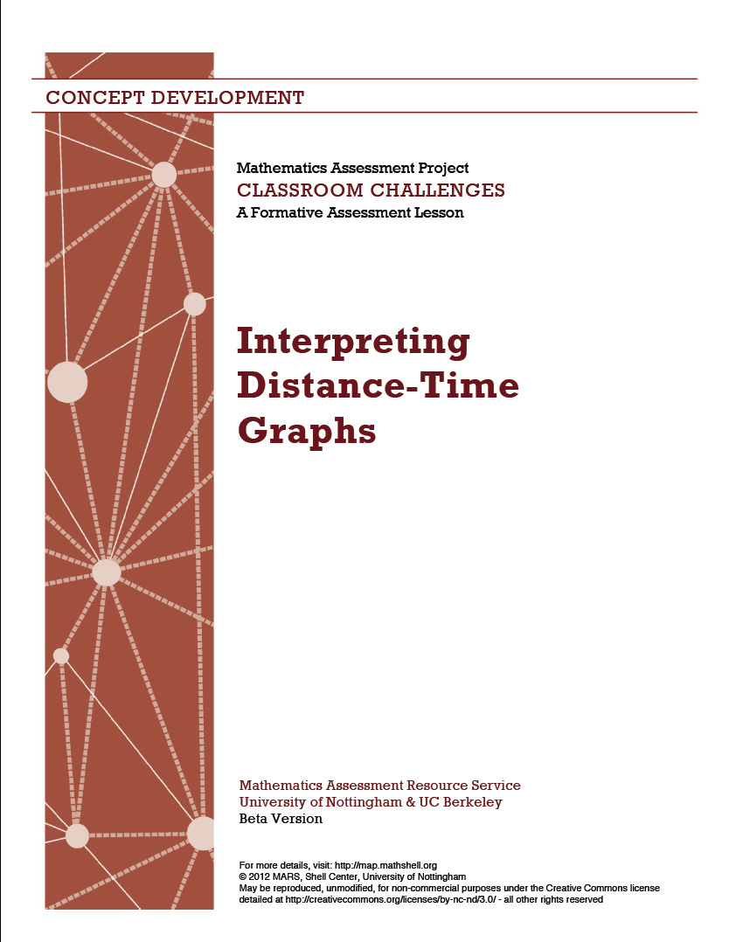

Slide 91
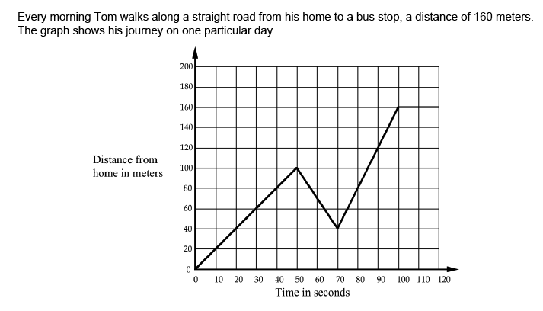
Before the lesson devoted to this topic, we give a diagnostic problem as homework:
Describe what may have happened. Is the graph realistic? Explain.

Slide 92
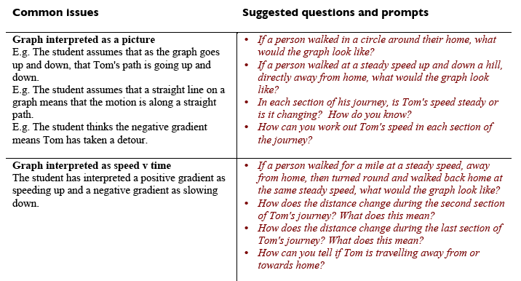
We point to typical student misconceptions and offer suggestions about how to address them…

Slide 93
The lesson itself begins with a diagnostic task…

Slide 94
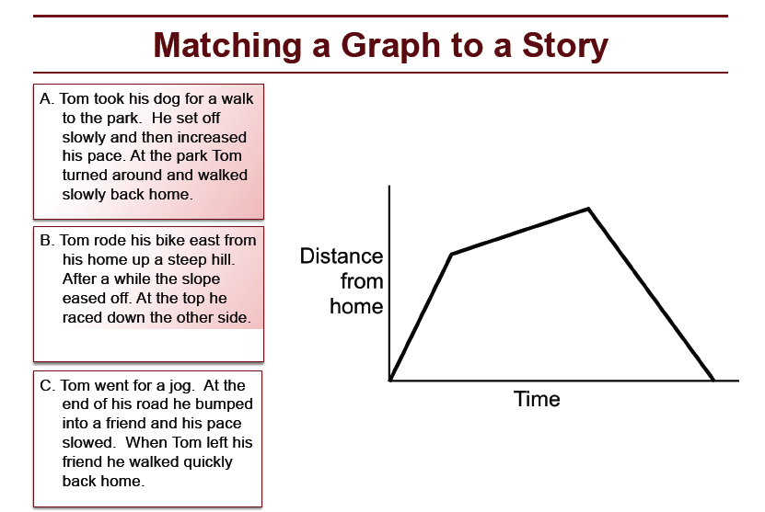

Slide 95
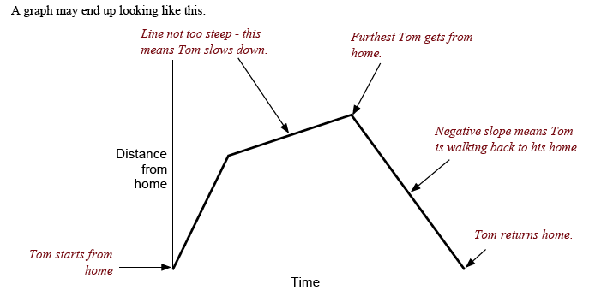
Students are given the chance to annotate and explain…

Slide 96
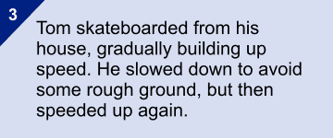
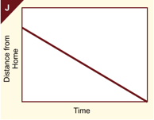
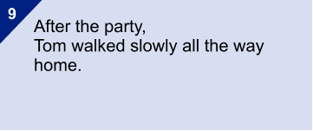
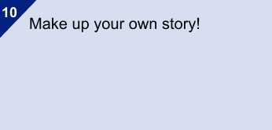
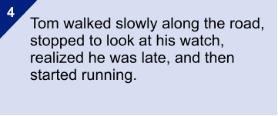
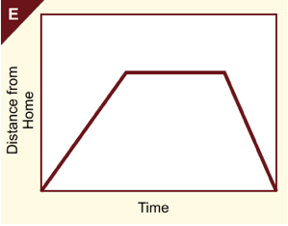
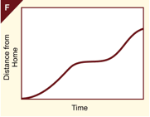
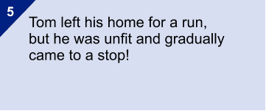
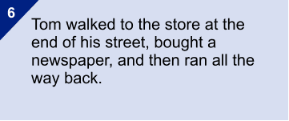
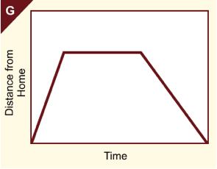
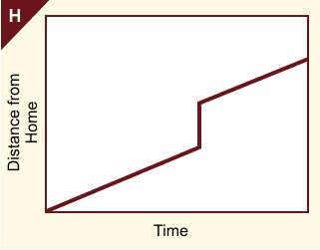
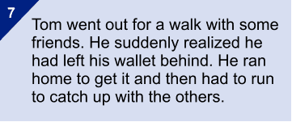
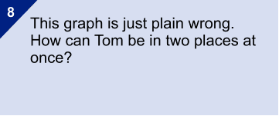
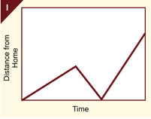
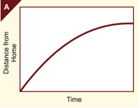
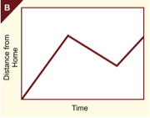
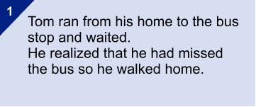
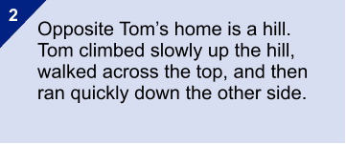
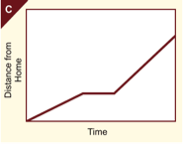
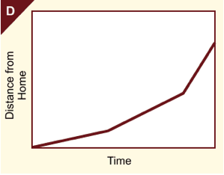
Matching stories to graphs- students make posters
Notes:
In these lessons students are then given ten graphs verbal descriptions to match.

Slide 97

Students work on converting graphs to tables:

Slide 98









Tables are added to the card sort…
And the class compares solutions together
Notes:
After students have matched graphs and stories, they are given tables, containing data for each situation, to match up.
You need to match all three: Graph to word, words to table, table to graph.
How does the table show running? Walking?
How does the graph show this?
Tables provoke a different way of seeing things – a different representation.
Teachers notice how adding the tables pushes students’ thinking and that they often see students changing matches for the graphs and stories because of the tables.

Slide 99


Slide 100
Now, let’s look at this FAL one dimension at a time.

Slide 101
The Mathematics
How rich and connected is the mathematical content?
The lesson focuses on developing deep understandings of concepts like slope, and its use to describe real world phenomena; it provides opportunities to make connections across different representations (graphs, tables, stories.)

Slide 102
Cognitive Demand
To what extent are students supported in grappling with and making sense of mathematical concepts?
The card sort and poster activities provide plenty of room for sense making – IF the students are gently scaffolded when they need it. (Remember the list of support questions)

Slide 103
Access to Mathematical Content
To what extent does the teacher support access to the content of the lesson for all students?
The classroom structures – which include whole group conversations, small group work, and student poster presentations – provide opportunities for teachers to support every student in engaging meaningfully with the mathematics. But . . . this takes hard work, even with the opportunities.

Slide 104
Agency, Ownership, and Identity
To what extent are students the source of ideas and discussion of them? How are student contributions framed?
The classroom structures – which include whole group conversations, small group work, and student poster presentations – provide opportunities for teachers to support every student in building powerful mathematical identities. But . . . this takes hard work, even with the opportunities.

Slide 105
Formative Assessment
To what extent is students’ mathematical thinking surfaced; to what extent does instruction build on student ideas when potentially valuable or address misunderstandings when they arise?
They’re called Formative Assessment Lessons for a reason… ☺

Slide 106
The FALs make a BIG difference.
And, as I noted, TRU Math and and FALs Math are deeply intertwingled.

Slide 107


Separated at Birth?
Well, maybe not.
But my mission is to make a difference.

Slide 108
And, I learned a HUGE amount from Malcolm and the Shell Centre team, every step of the way.
Notes:
First work, design task at 1st BA meeting
All the way to really understanding formative assessment when I went through the FALs closely
With a lot in-between.

Slide 109
The TRU Math Conversation Guide is designed to foster reflective conversations about instruction.
A Tool for Planning for and Reflecting on Teaching

Slide 110
Frame each dimension with questions:
The Mathematics
How do mathematical ideas from this unit/course develop in this lesson/lesson sequence?
Cognitive Demand
What opportunities do students have to make their own sense of mathematical ideas?
Equitable Access to Content
Who does and does not participate in the mathematical work of the class, and how?
Agency, Ownership, and Identity
What opportunities do students have to explain their own and respond to each other's mathematical ideas?
Formative Assessment
What do we know about each student's current mathematical thinking, and how can we build on it?

Slide 111
. . . and expand the questions,
to problematize instruction.
That is: Ask a series of questions that help to plan for instruction that provides students with deeper opportunities along each of the five dimensions.

Slide 112


The TRU Conversation Guide
Notes:
Now refer participants to Handout 4
I’m going to flip through the guide to show you what it looks like, and make a quick stop at
“access” to illustrate the kind of conversations its designed to support.

Slide 113


Slide 114
To support collegial observations,
we offer the
TRU Observation Guide,
Which highlights things to look for is a lesson is going well.
The guide can be used by coaches or TLCs for planning and debriefing classroom observations…

Slide 115






The TRU Observation Guide

Slide 116


Slide 117
The first version of the Observation Guide was actually built by San Francisco Unified School District, and it’s being used in a number of school districts across the US.
So, we’re really down to earth at this point!

Slide 118
Now let me turn to tools for building and supporting TLCs.
We’re in the middle of piloting these, so they’re not widely available.

Slide 119
The goal is to help “TRU” a department or TLC, assuming there is administrative and other support.

Slide 120
There are three tools in development and use:
An intro to TRU
A “deep dive” for each dimension
“On Target,” for deeper investigations

Slide 121
This is a workshop, with 3 videos, that allows a department to “discover” the TRU framework by itself.
An intro to TRU
(This was built as one of the tools for our joint “Network of Improvement Communities” project, an attempt to make a difference at the system level.)

Slide 122
Once a TLC “gets” TRU, they often pick a dimension to focus on.
Then what?
A common choice is “Agency, Ownership, and Identity.” We support the community in working on AOI with:
An intro using “safe” external videotapes;
Ongoing work using their own videos.
I’ll walk you through the general frame.

Slide 123
A TRU video discussion, with an emphasis on Agency, Ownership, and Identity

Slide 124
The Five Dimensions of Powerful Mathematics Classrooms
The Mathematics
Cognitive Demand
Equitable Access to Mathematics
Agency, Ownership, and Identity
Formative
Assessment
The extent to which classroom activity structures provide opportunities for students to become knowledgeable, flexible, and resourceful mathematical thinkers. Discussions are focused and coherent, providing opportunities to learn mathematical ideas, techniques, and perspectives, make connections, and develop productive mathematical habits of mind.
The extent to which students have opportunities to grapple with and make sense of important mathematical ideas and their use. Students learn best when they are challenged in ways that provide room and support for growth, with task difficulty ranging from moderate to demanding. The level of challenge should be conducive to what has been called “productive struggle.”
The extent to which classroom activity structures invite and support the active engagement of all of the students in the classroom with the core mathematical content being addressed by the class. Classrooms in which a small number of students get most of the “air time” are not equitable, no matter how rich the content: all students need to be involved in meaningful ways.
The extent to which students are provided opportunities to “walk the walk and talk the talk” – to contribute to conversations about mathematical ideas, to build on others’ ideas and have others build on theirs – in ways that contribute to their development of agency (the willingness to engage), their ownership over the content, and the development of positive identities as thinkers and learners.
The extent to which classroom activities elicit student thinking and subsequent interactions respond to those ideas, building on productive beginnings and addressing emerging misunderstandings. Powerful instruction “meets students where they are” and gives them opportunities to deepen their understandings.
Notes:
Just a reminder, no need to spend more than 10 seconds on this, unless it’s up there while people settle in

Slide 125
The General Goal:
Students become, and see themselves, as powerful mathematical thinkers who have strong senses of agency, ownership, and identity

Slide 126
Agency:
The disposition and capacity to act:
“I can do mathematics, and I’m willing to jump in and give it my best.”

Slide 127
Ownership:
Taking possession of knowledge by making it one’s own.
“I figured this out; it makes sense; it’s not simply what ‘they’ told me is true.”

Slide 128
Identity:
The sum total of who you are as a person.
“I am a math person. I like math; it makes sense; and I can figure things out.”

Slide 129
Today’s Goal:
Supporting our colleagues’ thinking about A/O/I opportunities in their classrooms, by reflecting on video

Slide 130
Part 1 – Just 5 minutes!
We remind the teachers of available tools:

Slide 131


Slide 132



Slide 133
Questions to Consider:
Agency, Ownership, and Identity
Who generates the mathematical ideas that get discussed?
Who evaluates and/or responds to others’ ideas? How does the teacher respond?
Which students respond? How do they respond?
How deeply do students get to explain their ideas?
How are norms developing around students’ and teachers’ roles in generating mathematical ideas?

Slide 134
Norms for Talking About Videos
Assume positive intent. Assume that every teacher does what he or she thinks is in the best interests of his/her students. If you question what they’re doing, think about why someone might think it’s the right thing to do.
Be open and curious regarding what you see, and what people say. We’re partners in trying to figure stuff out!
Do unto others… Say things in the way you’d like to hear them, if you were on the receiving end. That is, speak your truth thoughtfully.
Ask questions until ideas make sense. That’s what we’re here for!

Slide 135
Watch Tape 1

Slide 136
For Whole Class or Small Group:
How much ”room” is there for student thinking and exploration? Can more room be built in?
How is correctness determined? By looking to external authority (teacher or text), or working things through? Can more authority be ceded to the students?
Who initiates conversations? Can they be made made richer? Deeper? More participatory? How?
How long are students’ speech turns? Can they be expanded, deepened? In what ways?
Do student ideas get built on? By whom? Can these patterns be expanded?
Anything else?

Slide 137
For Student Presentations:
How comfortable are the students taking control in front of the class?
Can they be further positioned and supported as leaders, with things to share?
Whose math is it, theirs or external authority’s?
Can the presenters be further supported in explaining their own thoughts and ideas?
Who’s the audience, the teacher or fellow students? Which students are invited into the conversation, in what ways?
How can presenter-student dialogues be supported, further opening up A/O/I to the whole class?

Slide 138
Watch Tape 2

Slide 139
For Whole Class or Small Group:
How much ”room” is there for student thinking and exploration? Can more room be built in?
How is correctness determined? By looking to external authority (teacher or text), or working things through? Can more authority be ceded to the students?
Who initiates conversations? Can they be made made richer? Deeper? More participatory? How?
How long are students’ speech turns? Can they be expanded, deepened? In what ways?
Do student ideas get built on? By whom? Can these patterns be expanded?
Anything else?

Slide 140
For Student Presentations:
How comfortable are the students taking control in front of the class?
Can they be further positioned and supported as leaders, with things to share?
Whose math is it, theirs or external authority’s?
Can the presenters be further supported in explaining their own thoughts and ideas?
Who’s the audience, the teacher or fellow students? Which students are invited into the conversation, in what ways?
How can presenter-student dialogues be supported, further opening up A/O/I to the whole class?

Slide 141
Thanks, everyone, for being a great team!

Slide 142
Here’s our M.O.
We start with pre-selected videos, so the teachers learn how to watch and comment on videos.
Then, once they’re comfortable, we ask for a volunteer to share a video of his/her practice. That teacher is co-moderator of the session, so he/she has control.
Notes:
Say that we’ll be focusing on data gathering to help us see what’s in the tapes, and the reflection items in the next slide, in this discussion – BUT, all of the tools are useful and we hope they’ll be used for reflection when the teachers have more time.

Slide 143
This becomes our routine.
And, we have one more tool we’re starting to use:
Notes:
Say that we’ll be focusing on data gathering to help us see what’s in the tapes, and the reflection items in the next slide, in this discussion – BUT, all of the tools are useful and we hope they’ll be used for reflection when the teachers have more time.

Slide 144

Notes:
Say that we’ll be focusing on data gathering to help us see what’s in the tapes, and the reflection items in the next slide, in this discussion – BUT, all of the tools are useful and we hope they’ll be used for reflection when the teachers have more time.

Slide 145
Here’s a sample page…
Notes:
Say that we’ll be focusing on data gathering to help us see what’s in the tapes, and the reflection items in the next slide, in this discussion – BUT, all of the tools are useful and we hope they’ll be used for reflection when the teachers have more time.

Slide 146
The Mathematics
In what ways do classroom activities provide opportunities for students to become knowledgeable, flexible, and resourceful mathematical thinkers?
What is the main mathematical idea? How does it develop? How is it connected to what students know? How is it connected to the grade level content and practice standards?
The focus is a single procedure or concept in isolation
The lesson pulls together previous strands of content
Applications are unrealistic or contrived
A method is derived in a way that links to a basic idea
The content supports the development of a “big idea” at grade level
Previously studied ideas are generalized
Opportunities to make connections are not taken advantage of
Concepts and procedures are viewed through different representations and applications
There are opportunities for strategic thinking
The Mathematics
Alternative approaches are compared and contrasted
Situations are mathematized in ways that give meaning to symbols
The lesson builds on and connects to mathematics the students know
Content is not connected to students’ prior knowledge and experience.
Problem solving methods are presented as algorithms
A concept is applied in a real world context
Two ways of looking at a situation are linked mathematically
Content is routinized and students are not engaged in sense making.
The content is below grade level in ways that do not support grade level objectives

Slide 147
Will these tools help?
Time will tell.
But, they’re aimed at being supportive and adaptable (by virtue of problematizing).
And, some major school districts (Chicago, Oakland, San Francisco) are moving in TRU directions.

Slide 148
Ask me how things are going, next year.
And the year after…

Slide 149
THANKS!
Notes:
Before you dismiss this, remember that the TIMSS tapes were chosen to be representative nation-wide.

Slide 150
Impact-focused research in education
– how can it become more effective?
Lynne McClure
Notes:
Systemic change and teaching modelling
Over the last sixty years, teaching modelling has moved from initial explorations to becoming an established field, supported by research and the development well-engineered tools of various kinds. Yet, in typical classrooms around the world, autonomous student modelling remains rare. Recently, in Britain and the US at least, modelling has become an explicit element in the “intended curriculum”. But the usual difficulties of embedding innovation across an education system remain. This talk will analyse these barriers and, drawing on past initiatives around the world, suggest what may be needed to overcome them.

Slide 151

To see ourselves as others see us
Lynne McClure
September 2017

Slide 152


Ourselves: researchers, design researchers
Others: policy makers

Slide 153
Why does our work matter to policy makers?
Mathematics is a core skill for citizenship
A mathematically well educated population will contribute to the country’s economic prosperity
It’s a tool for social justice
Achievement in mathematics is one aspect of international comparisons eg Pisa
Part of a personal philosophy of education
https://mathsreports.wordpress.com/overall-narrative/mathematics-is-important/

Slide 154
Why does our work matter to us?
Mathematics is for human flourishing (Su, 2017)
play
beauty
truth
Social justice
Future prosperity
Education for life
https://mathsreports.wordpress.com/overall-narrative/mathematics-is-important/

Slide 155
Policy makers
Designers and researchers

Slide 156

A story

Slide 157
Curriculum coherence
..a national curriculum should have content arranged in an order which is securely based in evidence associated with age-related progression, and all elements of the system (content, assessment, pedagogy, teacher training, teaching materials, incentives and drivers etc) should all line up and act in a concerted way to deliver public goods
Schmidt & Prawat 2006

Slide 158
Control Factors
1 curriculum content (national curriculum specifications, textbooks, support materials, etc.)
2 assessment and qualifications
3 national framework - system shape (e.g. routes, classes of qualifications)
4 inspection
5 pedagogy
6 professional development (levels and nature of teacher expertise)

Slide 159
Control factors
7 institutional development
8 institutional forms and structures (e.g. size of schools, education phases)
9 allied social measures (linking social care, health care and education)
10 funding
11 governance (autonomy v direct control)
12 accountability arrangements
13 selection and gatekeeping (e.g. university admissions requirements) (Oates,2010)

Slide 160

Japan
Iterative model of curriculum development
Planned timescale (10, 5)
Changes made in response to Lesson Study findings
Teachers as solution not problem
PD focused on implementation of curriculum
Textbooks, assessments in same timescale

Slide 161
Maths for post-16
A prime example of policy decisions which cut across each other:
Main aim: increase participation post 16
GCSE resits = more students = even more teachers
Workforce planning: £65 million
Funding changes
GCSE grading changes
Core Maths, Underground Maths

Slide 162



Slide 163
DfE funded (Gove)
Meets aims of new NC
Increasing take up and feedback
Well connected to other maths education projects
Connected resources and PD
Embodies design cycle
Embedded philosophy
Integrity & connectedness of maths central
Archived – no institutional memory

Slide 164
Identifying intersection problems
Different ideas of what’s important - drivers
Different time scales – political expediency
Ideas of where expertise lies
No coordinated community responses

Slide 165
Things to consider
Research aspects that are of direct interest to policy makers, funded by those that understand
Coordinate and make visible source of expertise/evidence
Present a more united front – don’t respond to flattery – refer back to community
Know who to work with – key influencers are often hidden
Get known key players on side
Tsunami response – be prepared

Slide 166

ACME
Core committee (12) to act strategically
Contact groups (4) – experts from the community
ToR to monitor and feedback on implementation of mathematics education policy, especially NC
To prepare for the next round of curriculum development

Slide 167


Slide 168
The big picture
The framework will be:
  A connected map of mathematics from (3)-19
  Informed by research and expert opinion
  And, we hope, a basis for long term education strategies ensuring coherence between
  curriculum
  assessment,
  professional development,
  resources

Slide 169
Why is it so difficult to join up policies?
What can we do as a community to convince policy makers to engage with us?
What kind of alternative structures might be more effective?

Slide 170



Thank you
info@cambridgemaths.org
@CambridgeMaths
LinkedIn
cambridgemaths.org

